Slide 1
Introduction to Relational Model

Slide 2
General Guideline
© (2021) ABES Engineering College.
This document contains valuable confidential and proprietary information of ABESEC. Such confidential and proprietary information includes, amongst others, proprietary intellectual property which can be legally protected and commercialized. Such information is furnished herein for training purposes only. Except with the express prior written permission of ABESEC, this document and the information contained herein may not be published, disclosed, or used for any other purpose.

Slide 3
Module Objective
To describe the structure of Relational Model .
To understand database schema , relational model objects and characteristics of relations
To discuss different keys in relational database like Super Key , Candidate key ,Primary Key , Composite Key , Secondary Key or Alternate Key , Surrogate Key , Foreign and Unique Key
To explain different constraints like schema based or integrity , entity integrity or key , Referential integrity and domain constraints
To discuss SMS Case study with all constraints
To understand basic concepts of SQL

Slide 4
Session Plan
Structure of Relational Model
Database Schema
Relational Model Objects
Characteristics of Relations

Slide 5
Database Schema

Slide 6
Database Schema
The database schema description is called the database schema, which is specified during database design and is not expected to change frequently.
The term "schema" refers to the organization of data as a blueprint of how the database is constructed.
The concept of “relation schema” corresponds to the programming-language notation of the type definition .

Slide 7
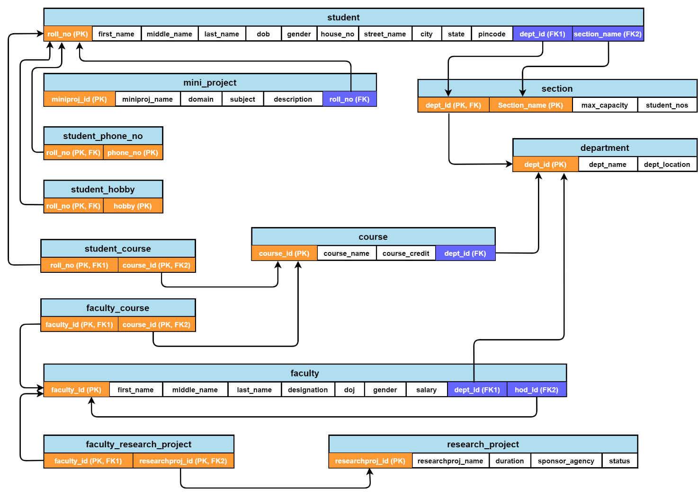
Relation Schema of SMS
Notes:
Database Instance is a snapshot of the data in the database at a given instant in time. The data stored in a database at a particular moment is called an Instance of a Database

Slide 8
Can you Answer this question
Q A snapshot of the data in the database at a given instant in time, is known as
Database Entity
Database Relation
Database Instance
Database Schema

Slide 9
Can you Answer this question
Q A snapshot of the data in the database at a given instant in time, is known as
Database Entity
Database Relation
Database Instance
Database Schema

Slide 10
Can you Answer this question
Q A logical schema....
Is the entire database.
describe data in terms of relational tables and columns, object-oriented classes, and XML tags.
Describes how data is actually stored on disk.
Both (A) and (C)

Slide 11
Can you Answer this question
Q A logical schema....
Is the entire database.
describe data in terms of relational tables and columns, object-oriented classes, and XML tags.
Describes how data is actually stored on disk.
Both (A) and (C)

Slide 12
Introduction
Conceptual Model
(ER Diagram)
Logical Model (Relational Model)

Slide 13
Relational Model
A Relation is a mathematical concept based on the ideas of sets.
The model was first proposed by Dr. E.F. Codd of IBM Research in 1970.
It provides a standard way of representing and querying data used by any application.

Slide 14
Relational Model Contd.
The most fundamental elements in the relational model are relations, which users and modern RDBMSs recognize as tables.
A relation is a set of tuples or rows, with each tuple sharing a set of attributes or columns.
A domain of possible values represents the data type describing the types of values that can appear in each column.
The number of attributes in a relation is called degree or arity.
SQL (Structured Query Language) has been widely used as the language for relational database queries.

Slide 15
Can you Answer this question
Q In a relational model, relations are termed as....
Rows
Tables
Attributes
Tuples

Slide 16
Can you Answer this question
Q In a relational model, relations are termed as....
Rows
Tables
Attributes
Tuples

Slide 17
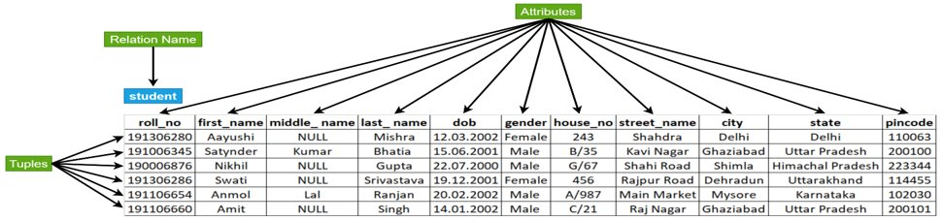
Relational Model Contd.

Slide 18
Can you answer these questions ???
Q. RDBMS consists of collection of ?
Record
Tables
Fields
Key

Slide 19
Can you answer these questions ???
Q. RDBMS consists of collection of ?
Record
Tables
Fields
Key

Slide 20
Can you answer these questions ???
Q. The term attribute refers to a _____________ of a table
Record
Tuple
Column
Key

Slide 21
Can you answer these questions ???
Q. The term attribute refers to a _____________ of a table
Record
Tuple
Column
Key

Slide 22
Can you answer these question
Q Which of the following refers to the number of attributes in a relation?
A. Degree
B. Row
C. Column
D. None of the Above

Slide 23
Can you answer these question
Q Which of the following refers to the number of attributes in a relation?
A. Degree
B. Row
C. Column
D. None of the Above

Slide 24
Relational Model Objects
Common Terminologies used in relational model objects are as follows : -
Database
Relation/Table
Attribute/Field/Column
Domain
Record/Row/Tuple
Degree/Arity

Slide 25
Formal Definition - Relation
A relation (or relation state) r of the relation schema R(A₁, A₂, … , A_{n}), also denoted by r(R), is a set of n-tuples r = {t₁, t₂, … , t_{m}}.
Each n-tuple t is an ordered list of n values t =<v₁, v₂, …,v_{n}>, where each value v_{i}, 1 ≤ i ≤ n, is an element of dom(A_{i}) or special NULL value.
The ith value in tuple t, which corresponds to the attribute A_{i}, is referred to as t[A_{i}] or t.A_{i}.
Notes:
Example : relation STUDENT of the relation schema STUDENT (roll_no, first_name, middle_ name, last_ name, dob, gender, house_no, street_name, city, state, pin code) is a set of 5-tuples r = {t₁, t₂, t₃, t₄, t₅}. Second tuple t₂ is an ordered list of 12 values t₂ = <191006345, Satynder, Kumar, Bhatia, 15.06.2001, Male, B/35, Kavi Nagar, Ghaziabad, Uttar Pradesh, 200100>, where a value suppose Kavi Nagar is an element from dom(street_name).

Slide 26
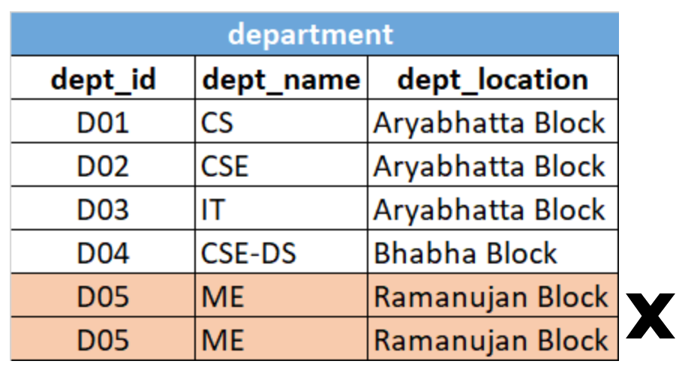
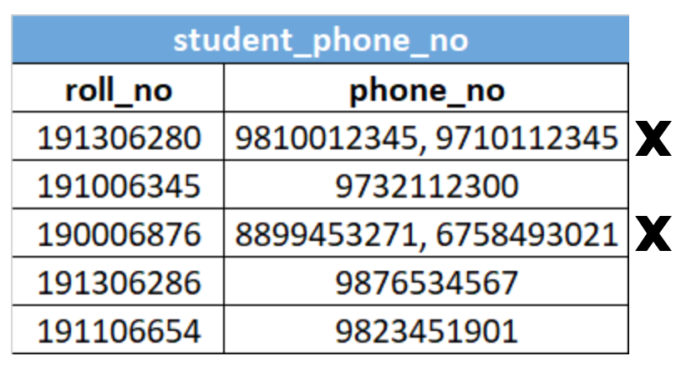
Characteristics of Relations
Duplicate tuples must not be present in a relation
Each tuple must have exactly one data (atomic) value for an attribute

Slide 27
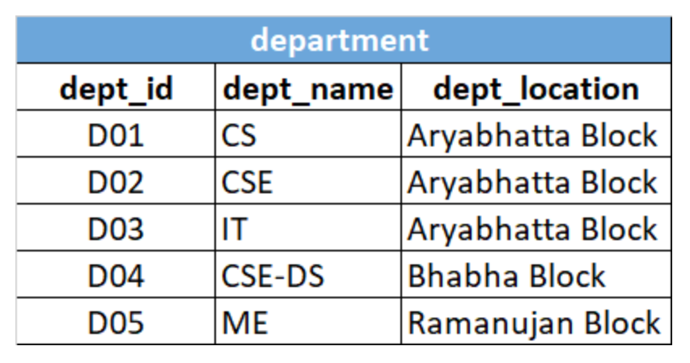
Characteristics of Relations
Each relation in a database must have a distinct or unique name that would separate it from the other relations in a database.
A relation must not have two attributes with the same name

Slide 28
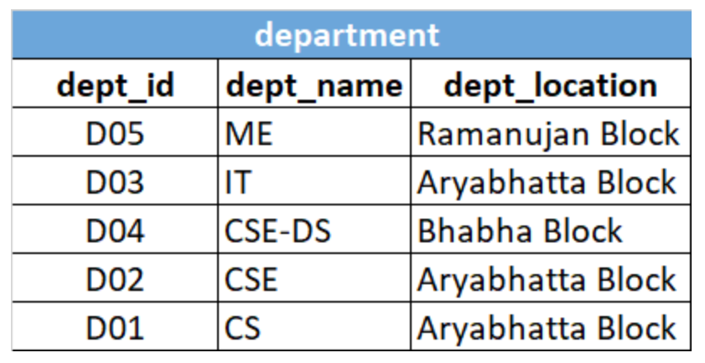
Characteristics of Relations
Tuples in a relation do not have to follow a significant order as the relation is not order-sensitive. Both of these DEPARTMENT relations are the same.

Slide 29
Formal Definition - Attribute
A relation schema R, denoted by R(A₁, A₂, …, A_{n}), comprises a relation name R and a list of attributes, A₁, A₂, …, A_{n.}
Each attribute A_{i} is the name of a role played by some domain D in the relation schema R.
The degree of a relation is the number of attributes n of its relation schema.
For Ex :
STUDENT relation: dom(roll_no): Roll_number; dom(first_name) :Names; dom(middle_name): Names; dom(last_name): Names; dom(dob) =Dates, dom(gender):Genders, dom(house_no): Address, dom(street_name): Address, dom(city): City_names, dom(state): State_names, dom(Pincode): Pincodes

Slide 30
Formal Definition - Domain
A domain is the original set of atomic values used to model data.
Domain can be specified via data type , format , and set of possible values from which the data values are drawn

Slide 31
Definition Summary
Informal Terms | Formal Terms
Table | Relation
Column Header | Attribute
All possible column values | Domain
Row | Tuple
Table Definition | Schema of Relation

Slide 32
Can you answer these questions?
Q) A two-dimensional table of data is called a _____?
Group
Set
Relation
Declaration

Slide 33
Can you answer these questions?
Q) A two-dimensional table of data is called a _____?
Group
Set
Relation
Declaration

Slide 34
Can you answer these questions?
Q) Related fields in a database are grouped to form a..
Data file
Data record
Menu
Bank

Slide 35
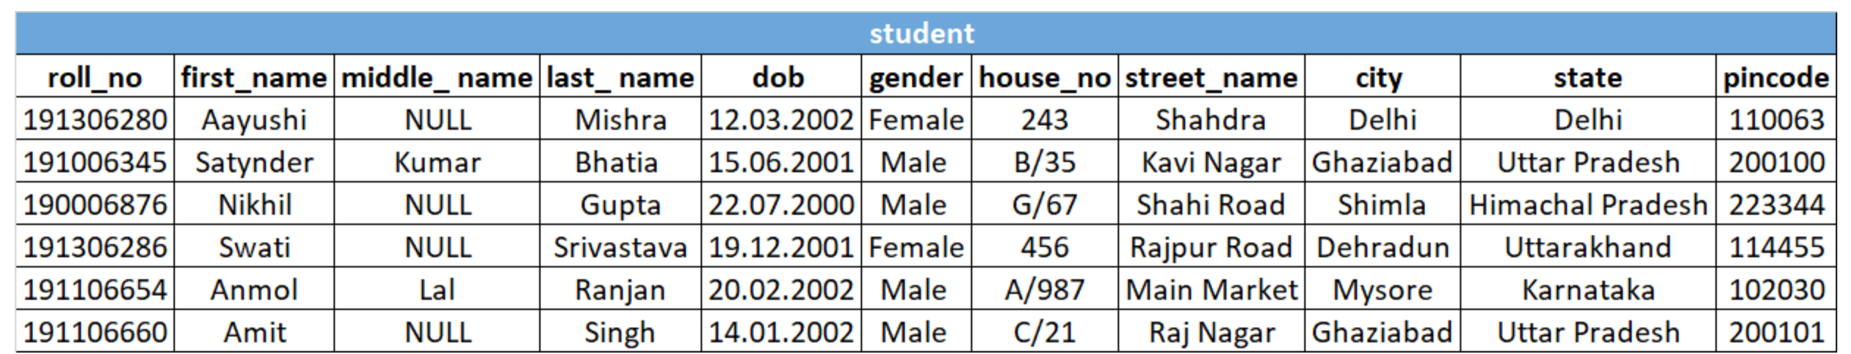
Importance of Relation Models
It is best suitable for managing the structured in the database.
It represent the database as a collection of relations .
Each row in the table represent a collection of related data value ( when relation is represented in table) .
The table name and column names are used to help to interpret the meaning of values in each row

Slide 36
Can you answer these questions?
Q) A person, place, thing, event, or condition about which data is kept in the database is called _____?
Field
Attribute
Record
Entity

Slide 37
Can you answer these questions?
Q) A person, place, thing, event, or condition about which data is kept in the database is called _____?
Field
Attribute
Record
Entity

Slide 38
Can you answer these questions
Q1) Describe the difference in meaning between the terms relation and relation schema (Korth).
Q2) What are the importance of Relational Model?
Q3) Describe few characteristics of relations ?
Q4) What is difference between Schema and Instance in DBMS?

Slide 39
Summary
Understanding the structure of Relational Model .
To understand database schema , relational model objects and importance of relational model objects
To understand the basic terminology used in relational model
To get brief introduction of relations, tuples and domain with example

Slide 40
Thank You

